Slide 1

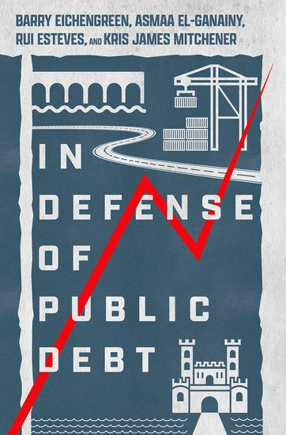



Slide 2


Slide 3

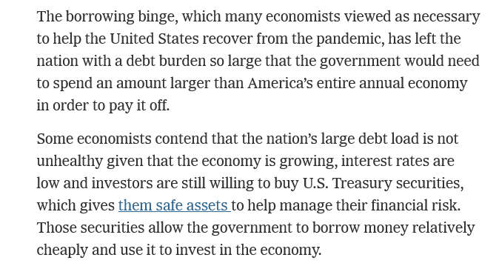

Slide 4

Early public debt history is European history
Because war was especially prevalent in Europe.
  The European continent was divided into literally hundreds of princely kingdoms, many no more than cities with modest hinterlands.
  Average state size was just 25,000 sq. kilometers (Tilly).
  Europe’s geography as a landmass riven by mountain ranges and river valleys posed natural obstacles to the formation of more extensive territorial states.
    With apologies to Jared Diamond…

Slide 5

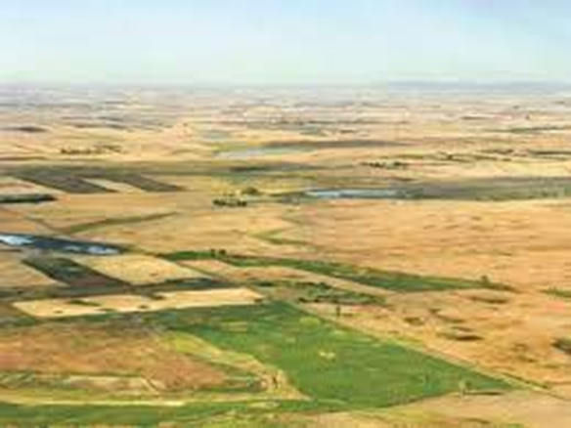
Contrast China
Much of which is a great plain.
The Qin established a unitary state already in 221 BC.
As well as a uniform written language, standardized currency and unitary tax system.
And of course one of Emperor Qin Shi Huang’s first projects (221 BC) was the Great Wall.
For reasons of geography and internal unity, China lacked the same need to borrow to finance warfare.

Slide 6

But, from the start, sovereign borrowing was subject to commitment problems
The king or sovereign was the supreme earthly power and embodiment of the state. (“L’Etat c’est moi.”) But this unlimited power limited his ability to borrow, since there was nothing to prevent him from reneging on his obligations.
Sovereigns could borrow, it followed, only for short terms and at high interest rates.

Slide 7
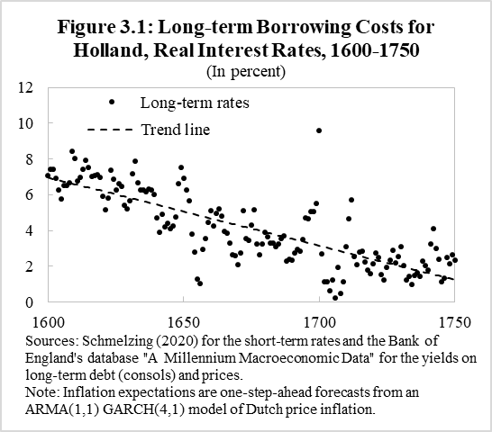
Political preconditions
Sovereign debt began its progressive rise to modern levels, therefore, only with the creation of representative assemblies, in which the creditors sat and were empowered to oversee tax collection, approve increases in spending, and authorize issuance.
With the creation of such assemblies in Italian city-states such as Florence, Genoa and Venice and then in the Netherlands and England, real interest rates on sovereign debt came down.
Sovereign debt came to be recognized as an obligation of the state rather than the person occupying the throne.

Slide 8
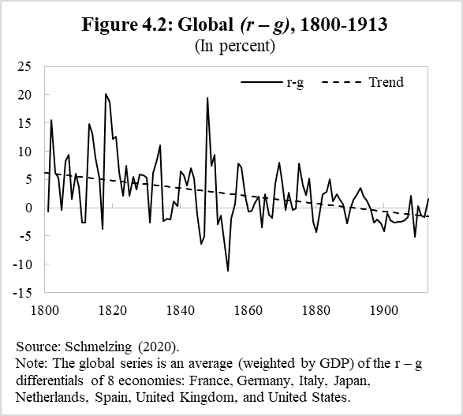
Economic preconditions
Not only did real interest rates come down, but come the 18th and 19th centuries economic growth rates went up.
Making heavier debts more sustainable.
In this sense modern public finance and modern public debt levels are corollaries of modern economic growth.

Slide 9

More economic preconditions
In addition, in order to place debt in private hands, there had to be a population of individuals with savings to invest.
  Not surprisingly, we see the successful placement of public debt in private hands in the same times and places where commercial activity was expanding. Venice, Genoa, the Netherlands, and Great Britain, which were among the public debt pioneers, were all major naval and commercial powers in their day.
  Similarly, French towns that were home to the Champagne fairs were among the first jurisdictions to successfully market first municipal and then sovereign bonds.

Slide 10

Financial preconditions
Finally, successful debt issuers had to meet financial preconditions.
  They had to create secondary markets on which debt securities could be bought and sold, allowing investors to diversify their claims and limit their risks.
  They had to create an entity, generally a central bank, to backstop this market, ensuring its stability and liquidity.

Slide 11

With spillovers to private markets
As government debt securities came to be seen as increasingly safe and liquid, they were accepted as collateral for other borrowing and lending.
Thus, the growth of transactions in private debt provided a spur for the broader process of economic and financial development.
Scholars of the Great Divergence sometimes ask “why Europe was first” -- why was it the first part of the world to experience modern (sustained) economic, financial and commercial development?
This precocity in issuing public debt is not the entire story. But it is part.

Slide 12
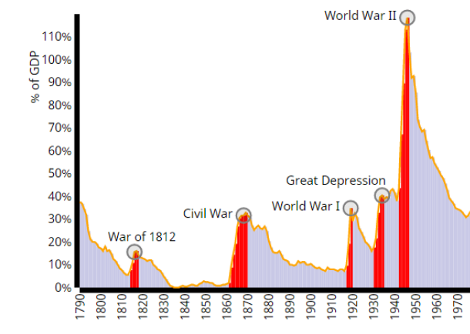
Over time, uses of public debt evolved
Financing wars has always been of premier importance.
  U.S. case is at right.
To meet public-health emergencies
  Sienna and Venice in the 14th century.
Starting in the 19th century, governments also borrowed to invest in productive infrastructure – roads, railways, ports, urban lighting and sewers – associated with modern economic growth.
  Dutch states have borrowed, periodically, to finance investments in “climate abatement” over 7 centuries.

Slide 13
So while responsible states borrow to meet emergencies
They also enhance or restore that capacity once the emergency has passed.
There will be another emergency: another novel coronavirus, a financial crisis, a climate disaster, a geopolitical event.
So prudent governments need to start thinking now about that restoration process.

Slide 14
In the book we look at a number of historic debt consolidation episodes
To highlight what is different between now and then – and what might be possible now.
Where d is debt/GDP
Where p is primary surplus/GDP
Where sfa is the stock/flow adjustment
Where now i and γ are the nominal interest rate and growth rate respectively.

Slide 15
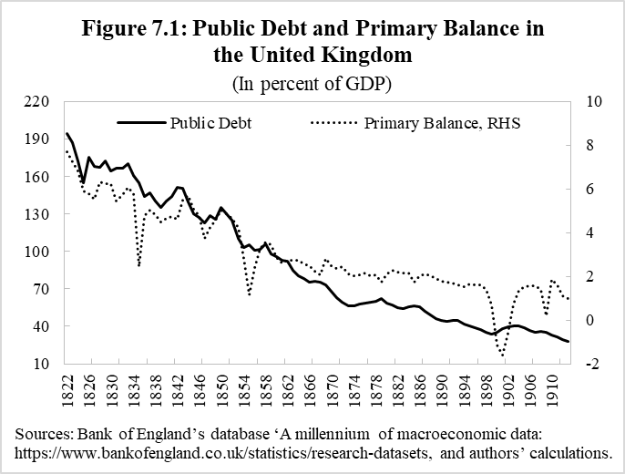
Britain
Achieved entirely by fiscal effort.
What made this possible?
  Victorian philosophy of sound finance.
    Sound finance was integral to the fiscal philosophy of Peel & Gladstone emphasizing budget surpluses, low taxes and limited government.
  All in the service of preserving the ability to borrow in a future conflict.
  Limited influence of working class in Parliament (even after reform acts).

Slide 16
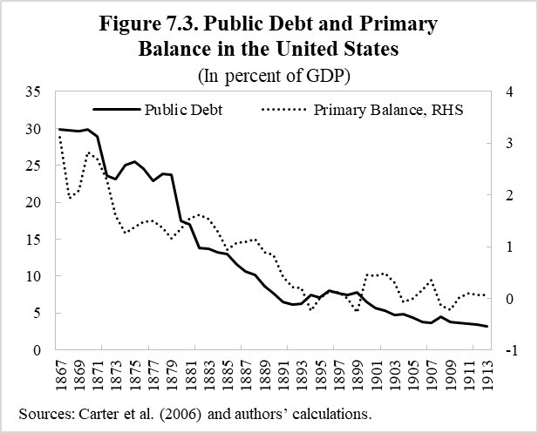
United States
Achieved entirely by fiscal effort (as we will see).
What made this possible?
  Strong creditor influence as reflected in the decision to return to gold (and Populist complaints about powerful banks and trusts).
  Southern states opposed expansive federal spending.
  Limited military spending needs prior to Spanish-American War.
  Growth and immigration are widely seen as the story; not true (as I’ll show you in a moment).

Slide 17
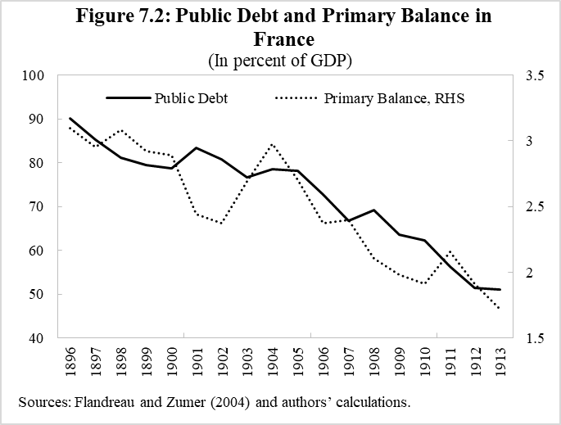
France
Again achieved entirely by fiscal effort (as we will see momentarily).
What made this possible?
  Elites saw new taxes as a necessary evil, as enabling the country to prepare for another German war.

Slide 18
In each case, primary surpluses account for more than 100% of the observed decrease
Basic debt dynamics:

Slide 19
In each case, primary surpluses account for more than 100% of the observed decrease
Basic debt dynamics:

Slide 20
So can we exert analogous fiscal effort now?
Through persistent primary surpluses?
  Only under special circumstances.
  Norway after 1999, Belgium after 1995, Singapore after 1990.

Slide 21
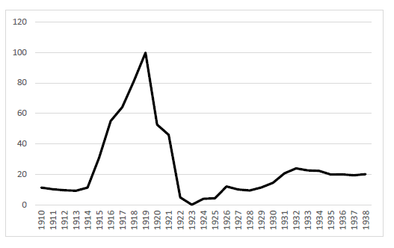
We also analyze other cases (post WWI) one wouldn’t want to emulate
Public debt ratio in Germany 1910-1938
Liquidation through inflation in Germany.
Leading to very high borrowing costs and rising debt thereafter.
Not to mention political polarization.

Slide 22

What about instead inflating away the debt?
Some economists, such as Charles Goodhart, argue that debts will be inflated away, as in Weimar Germany.
  I’m skeptical.
    Investors will adjust maturities, so the increase in inflation will have to be a very big and/or repeated surprise.
    And stability culture is deeply ingrained in today’s central banking community.

Slide 23
What about inflation more generally?
When we consider debt consolidations (>25% of GDP) of any length, we see many (short) episodes where inflation surged and interest rates failed to keep up.
(Where the real rate went negative, contributing positively to fiscal consolidation.)
But when we look at ten-year episodes, the contribution of real rates turns negative.
(Expectations and maturities adapt. Interest costs rise even faster than inflation, such that inflation contributes negatively to debt consolidation.)

Slide 24
What about inflation more generally?
When we consider debt consolidations (>25% of GDP) of any length, we see many (short) episodes where inflation surged and interest rates failed to keep up.
(Where the real rate went negative, contributing positively to fiscal consolidation.)
But when we look at ten-year episodes, the contribution of real rates turns negative.
(Expectations and maturities adapt. Interest costs rise even faster than inflation, such that inflation contributes negatively to debt consolidation.)

Slide 25



What about faster growth?
Growing the denominator of the debt/GDP ratio
  This is what Europe is hoping for with its Recovery Fund and the Biden Admin promises with its Infrastructure Plan.
  Maybe COVID has accelerated digitization.
  But no evidence of this yet.
  And history suggests that productivity growth accelerates in response to general purpose technology shocks only with a lag.

Slide 26
All of which is to say that there are no simple solutions
History shows that countries that have successfully addressed problems of debt sustainability without major economic, financial and political dislocations have done so by turning to fiscal restraint when the time was right (not before), by growing their economies, and by avoiding deflation (and maybe even running modest rates of inflation).
Failing to address the problem from all three angles is a recipe for disaster.

Slide 27
Coda: and implications of war in Ukraine?
Strong argument for debt finance of war- and energy-shock related spending (on food and fuel offsets for poor households and even military outlays), given that household consumption will fall due to uncertainty, reduced exports etc.
10-year Treasury rate in EA = 1.6%
Inflation forecast for 2022, @ IMF = 5.3%
Growth forecast for 2022, @ IMF = 2.8%
So combined with a debt/GDP ratio of 100%, this means that EA can run a budget deficit of 1.6 – 5.3 – 2.8 = 6.5% of GDP while keeping the debt ratio stable.
If you think that recession is looming (imagine EU growth of -1%), this implies a primary deficit of 2.7% while keeping debt ratio stable.
Primary deficit was 3.6% of GDP in 2021. So staying out of recession will be key for fiscal sustainability (as for everything else).

Slide 28
And what about Italy?
With 10 year Treasury yield = 3%
Growth 2%, inflation 5 ½ %, debt/GDP = 150%
Primary deficit can = 6.75% if GDP without debt going up, and primary surplus = +2%
In medium term, growth ½ %, inflation 1 ½ % (GS estimates), primary surplus must = 1 ½ %.
So Italy has very limited room for maneuver.
And if growth goes negative in recession, all bets are off.

Slide 29
Thank you.

