Slide 1
Political Economy of Putin’s War in Ukraine
Sergei Guriev
January 10, 2023

Slide 2
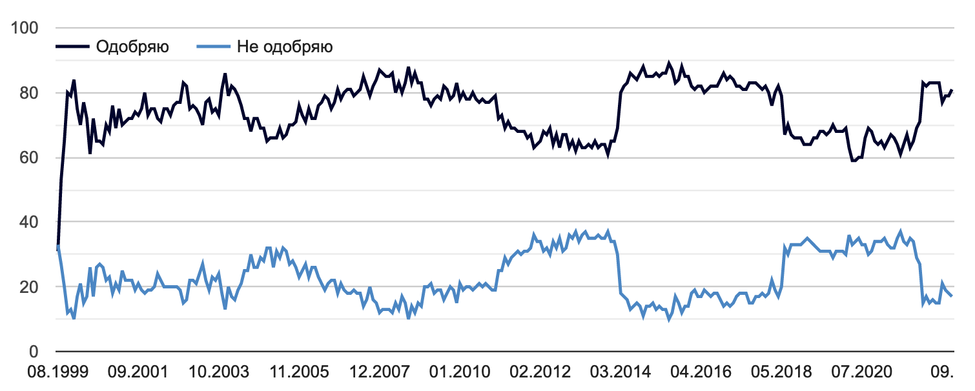
Putin’s approval rating
Approve
Disapprove
Crimea
Raising retirement age
Covid
Source: Levada Center

Slide 3
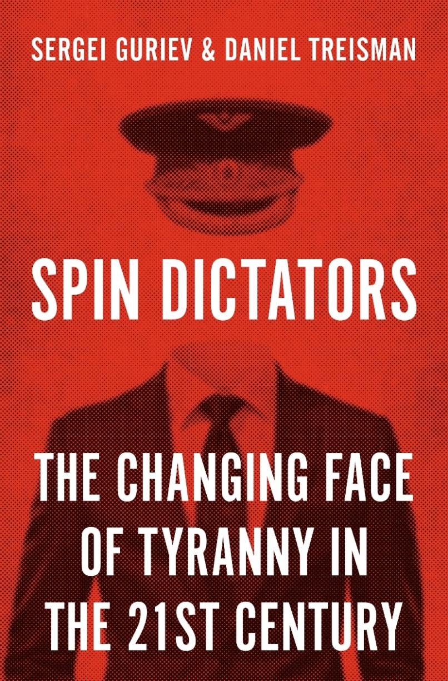
Central idea:
Instead of scaring people into obedience, most modern autocrats manipulate information to project image of competent leadership.

Slide 4
Pre-war economic outlook: micro vs. macro
Stagnation: average GDP growth rate in 2013-19: 0.9 % per year
Falling household incomes
Slow economic growth
Robust macro
Balanced budget (based on $44/barrel),
Large sovereign wealth fund: 12% GDP
Inflation targeting
Recapitalized banking system
Capital outflow: about 4% GDP per year
Investment/GDP stagnating at 20-22%
Low debt: 20%GDP sovereign debt (including 5%GDP external), 30%GDP total external debt
Large currency reserves (40% GDP)
Projected to continue stagnating after Covid

Slide 5
Middle income trap: Russia is not South Korea
Source: IMF. Solid: Russia. Dashed: Korea (-11 years).

Slide 8
The only major economy with a balanced budget in 2022-24
Source: IMF Oct 2021

Slide 9
Putin’s approval rating
Approve
Disapprove
Crimea
Raising retirement age
Covid
Source: Levada Center

Slide 10
Pre-war sanctions: very minor impact
Survey by Korhonen (2019)
Impact on trade
Ahn and Ludema (2020) “The sword and the shield”: targeted firms suffer but state’s protection of strategic firms helps
Crozet and Hinz (2020): 7% reduction in exports for Russia, 0.3% reduction in exports for the West
Micro studies
Countersanctions
Volchkova and Kuznetsova (2019): 0.5% GDP annual loss of consumer surplus, 0.05%GDP deadweight loss
Paper | Period | Effect on GDP
IMF (2019) | 2014-18 | 1%
Pestova and Mamonov (2019 | 2014-15 | 1.2%
Kholodilin and Netšunajev (2019) | 2014-16 | No effect
Barsegyan (2019) | 2014-17 | 1.5% in total

Slide 11
Sanctions 2022
Despite substantial increase in oil prices …
Certain sanctions were priced in before the war
Actual sanctions went much farther
Total blocking sanctions again almost major banks
Ruble-denominated stock price index lost about 20%
The worst-case sanctions scenario expected: switching off SWIFT
Unprecedented sanctions against Russian Central Bank
Including freezing its currency reserves
Formally, do not cover gold (22%) and yuan (13%) – but de facto these cannot be used as well
Ruble lost about 10% relative to “pre-tension” times
Comprehensive export controls including chips, aircraft, software
Joint by voluntary boycott by 1200+ Western and some non-Western companies -> major fall in imports
Finally, oil sanctions started in Dec 2022

Slide 12
GDP forecasts for 2022, Spring 2022
Pre-war forecast: +3%
Consensus forecast: -8%
Central Bank of Russia: -8%
EBRD: -10%
Goldman Sachs: -10%
JPMorgan: -11%
Institute for Int’l Finance: -15%
This would be the worst recession since early 1990s

Slide 13
Reality much less grim
Official prediction: - 3%
IMF (WEO Oct 2022): - 3.4% (and further -2.3% in 2023)
Consensus Economics (Dec): - 3.5%
BOFIT: - 3% (and further – 3-4% in 2023)
Plus, a stronger ruble and a lower inflation

Slide 14
Ruble is strong … but still weaker than would be predicted by high oil prices

Slide 15
Why?
High oil prices
Given high oil prices, Russia should have grown even more than +3% in 2022
During the war, GDP is not a good measure of economic activity
Includes production of munitions
EU oil sanctions only started in December
Huge current account surplus
Unrealistic expectations in the Spring
Unprecedented sanctions
Financial panic – reigned in by competent regulations plus open political repression
Other measures show much worse performance:
E.g. retail turnover: -10% year on year
Non-oil taxes: -9% year on year

Slide 16
Trade surplus and current account surplus, 1Q-3Q, $bln

Slide 17
What next?
Oil sanctions will result in substantial (but not catastrophic?) budget deficit 2.5% annual GDP in December alone
Economy
Politics
Sanctions do constrain Putin’s military spending and access to technology
Recession will continue in 2023
Instead, he will complete the shift from spin dictatorship to fear dictatorship
Tightening censorship and repression
And cleansing Russia of “national traitors”
Major long-term negative impact on growth
Capital flight and brain drain will continue
Losing the war will eventually create political problems for Putin
Economic shock may not be enough to stop Putin right away

Slide 18
IMF: current GDP forecast vs pre-war forecast

Slide 19
Broader geo-economic and geo-political context
Global economy?
Energy market?
Grain market?
Inflation?
European Union?
Relationship with the Global South?
Relationship with China?

