Slide 1
Ukrainian Refugees in the EU Labour Market: Challenges and Opportunities
50th Anniversary Ceremony and wiiw Spring Seminar 2022
3rd June 2022
Maryna Tverdostup

Slide 2
The inflow of refugees
Scale unseen since WWII

Slide 3
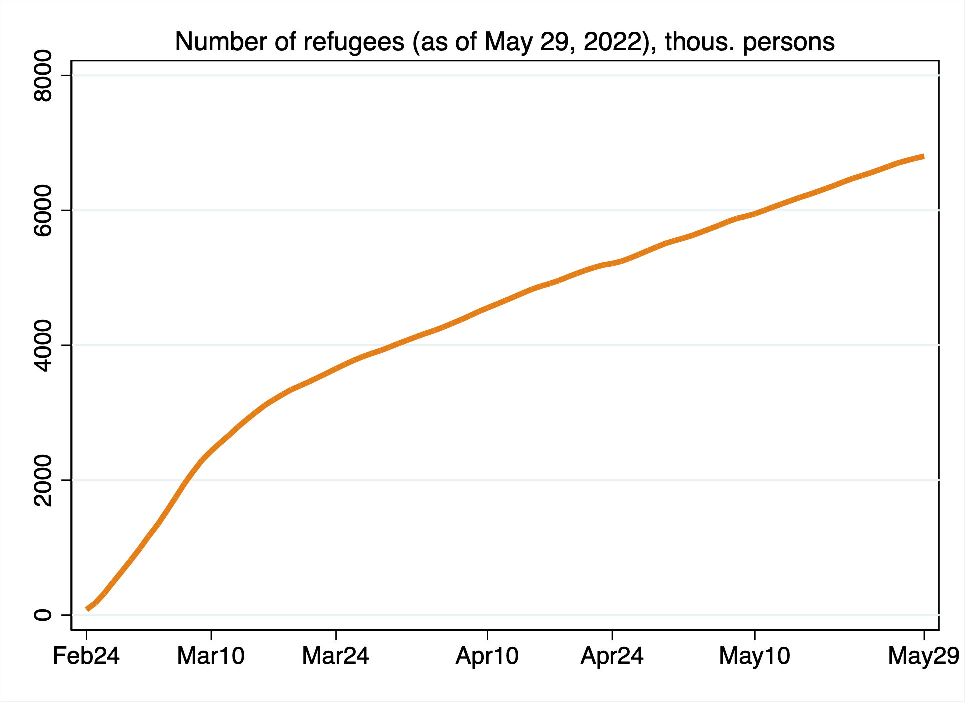
As of 29 May, 2022 over 6.8 million Ukrainians left the country
Net outflows of over 4 million so far
Yet, by the same date over 2.2 million Ukrainians returned home → over the first weeks of war mainly men, later – women and children who earlier left the country

Slide 4
A very different refugee crisis faced by Europe
Why?

Slide 5
1. Majority – (young) women with children
Over 80% of refugees are women
Average age – below 40
About 20% migrated alone
Remaining 80% migrated with at least one family member/friend, of whom around 60% arrived with at least one child
➜ Very different needs compared to earlier refugee waves According to various surveys conducted in Germany, Moldova, and Poland in April-May 2022

Slide 6
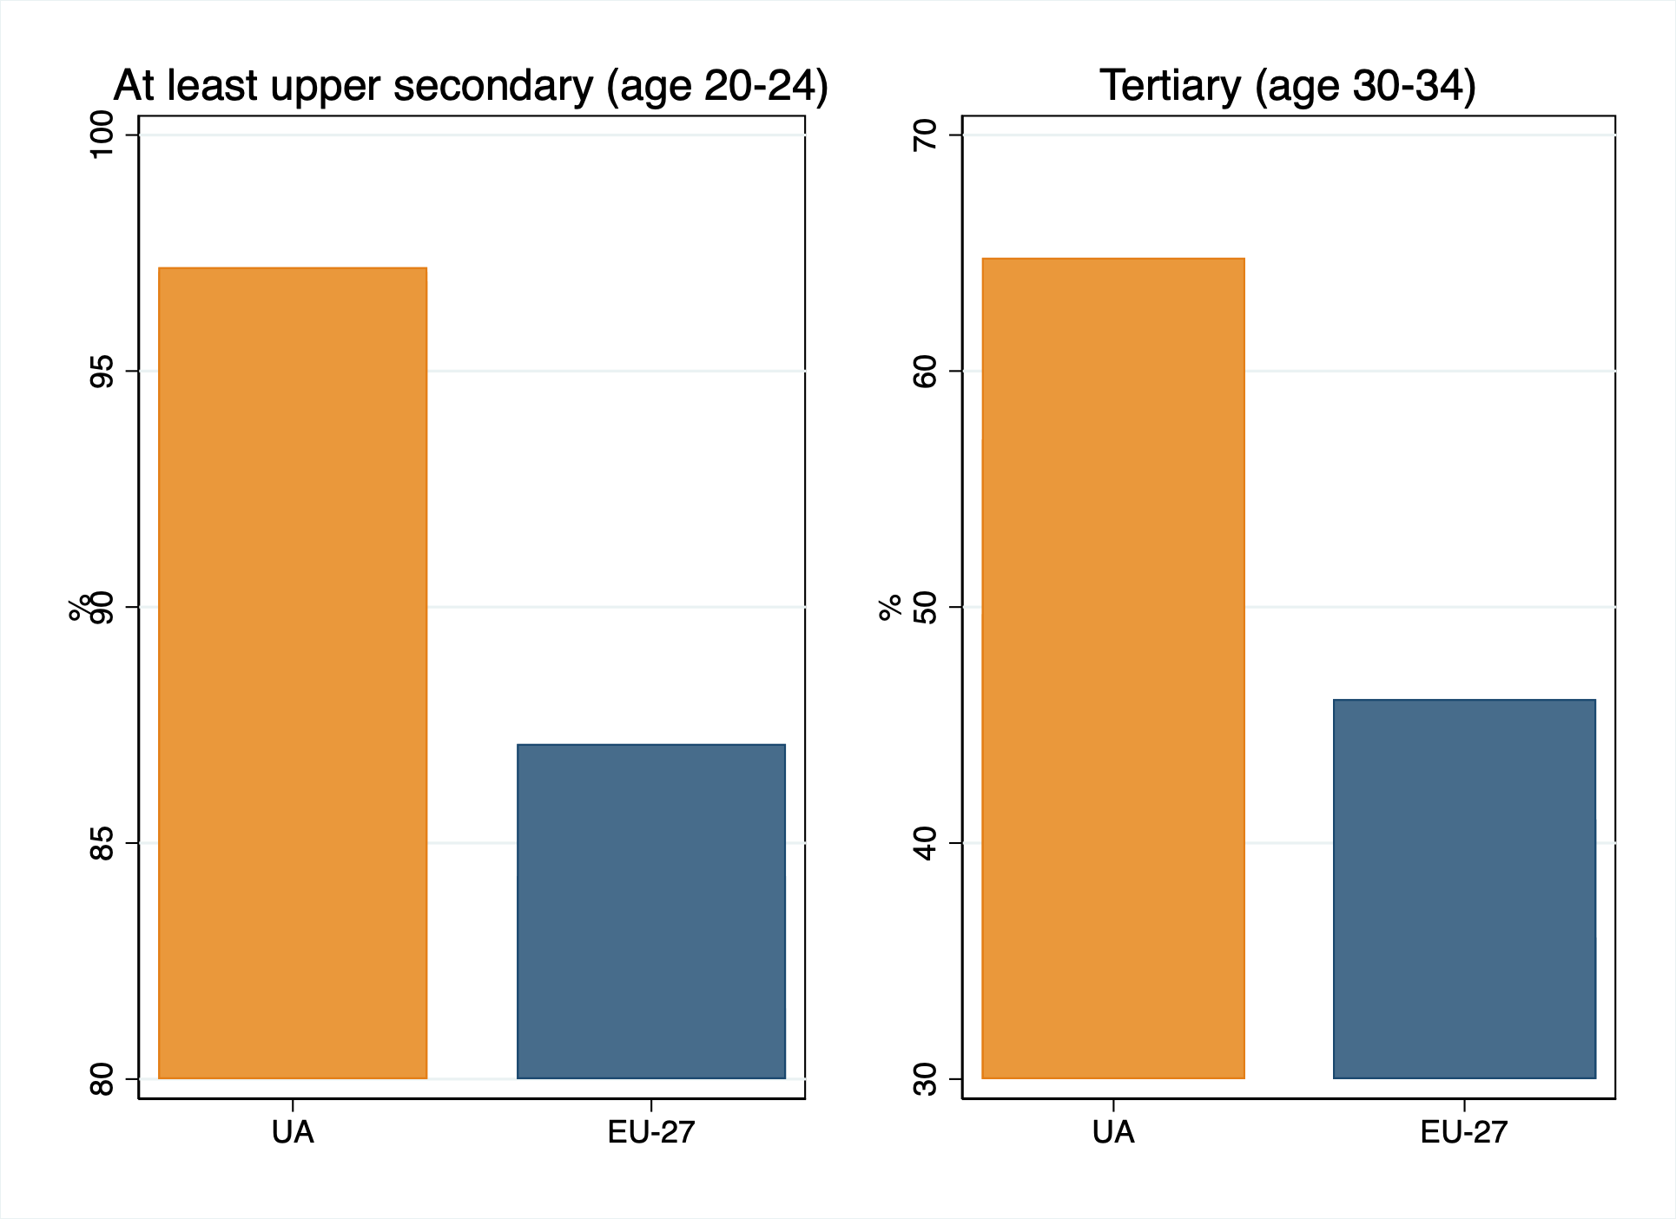
2. Well-educated women…
Data source: UA – the national statistical office; EU-27 – Eurostat; 2020

Slide 7
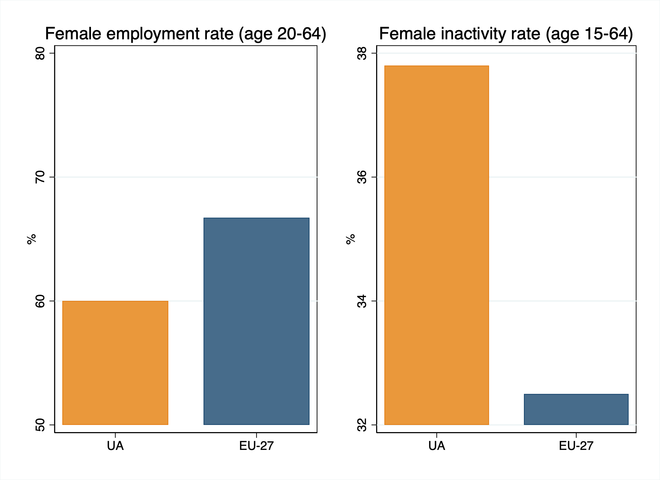
... Yet lacking work experience
Data source: UA – the national statistical office; EU-27 – Eurostat; 2020

Slide 8
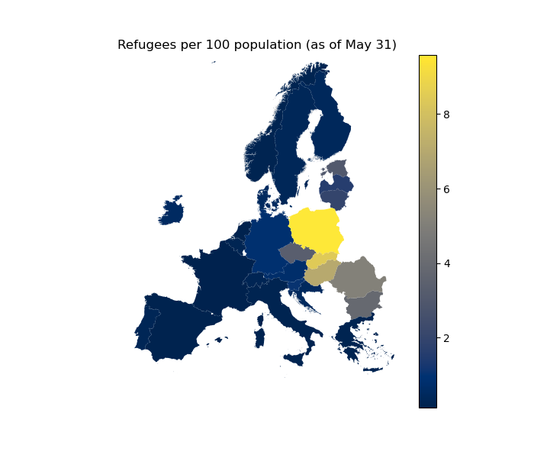
3. “Bunching” in the
EU-CEE countries and Moldova
➜ Moldova, Poland, Slovakia, Hungary and Romania has the highest number of refugees (as % of total population) registered
Data source: government reported figures; own calculations.

Slide 9
4. The EU response – unprecedentedly welcoming
The Initial EU response was positive ➜ strong basis for refugee
integration
Temporary protection scheme:
High chances for refugees to find a job
(Relatively) Easy movement within EU to find work
Limited risks of exploitation
Matching of skills to employment
Not too much pressure on any single member state

Slide 10
5. Not necessarily intending to stay long-term
As for mid-April outflow of refugees from the EU outnumbers the inflow
What is shaping the intention to stay/return:
Family separation
Limited accommodation capacity
Employment success
Geographical proximity

Slide 11
Integration prospects
Key opportunities and challenges

Slide 12
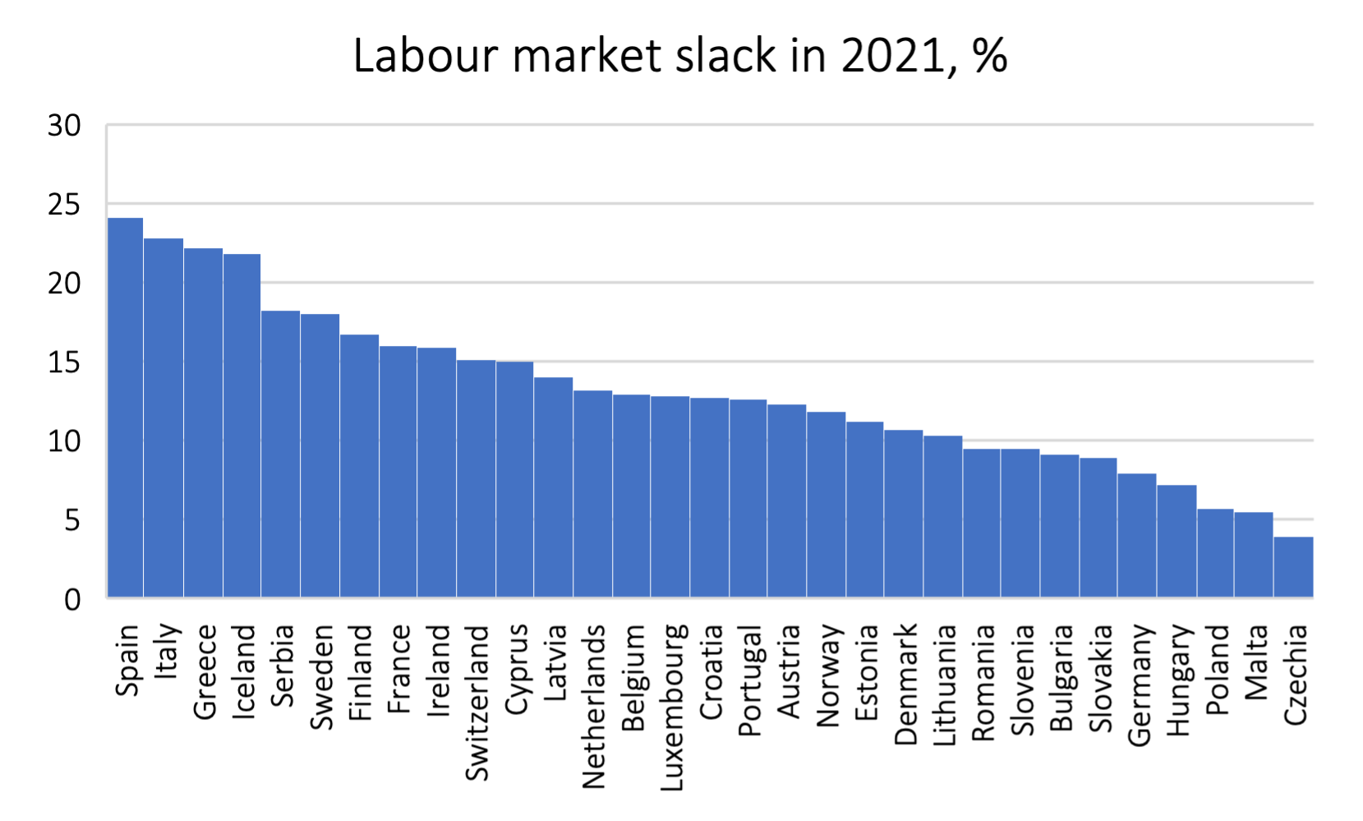
The EU labour market in dire need of workers – an opportunity
for refugees
➜ Looming lack of labour will allow to find at least temporary jobs quickly
Data source: Eurostat.

Slide 13
Before even talking about employment... Childcare!
Employment possibilities of women with minor children are limited by:
(Full-day) childcare accessibility/costs (for those with small children)
Enrolment in local schools (for those with primary school-age children)
➜ Magnifies pre-existing issue of childcare shortages (especially in big cities)

Slide 14
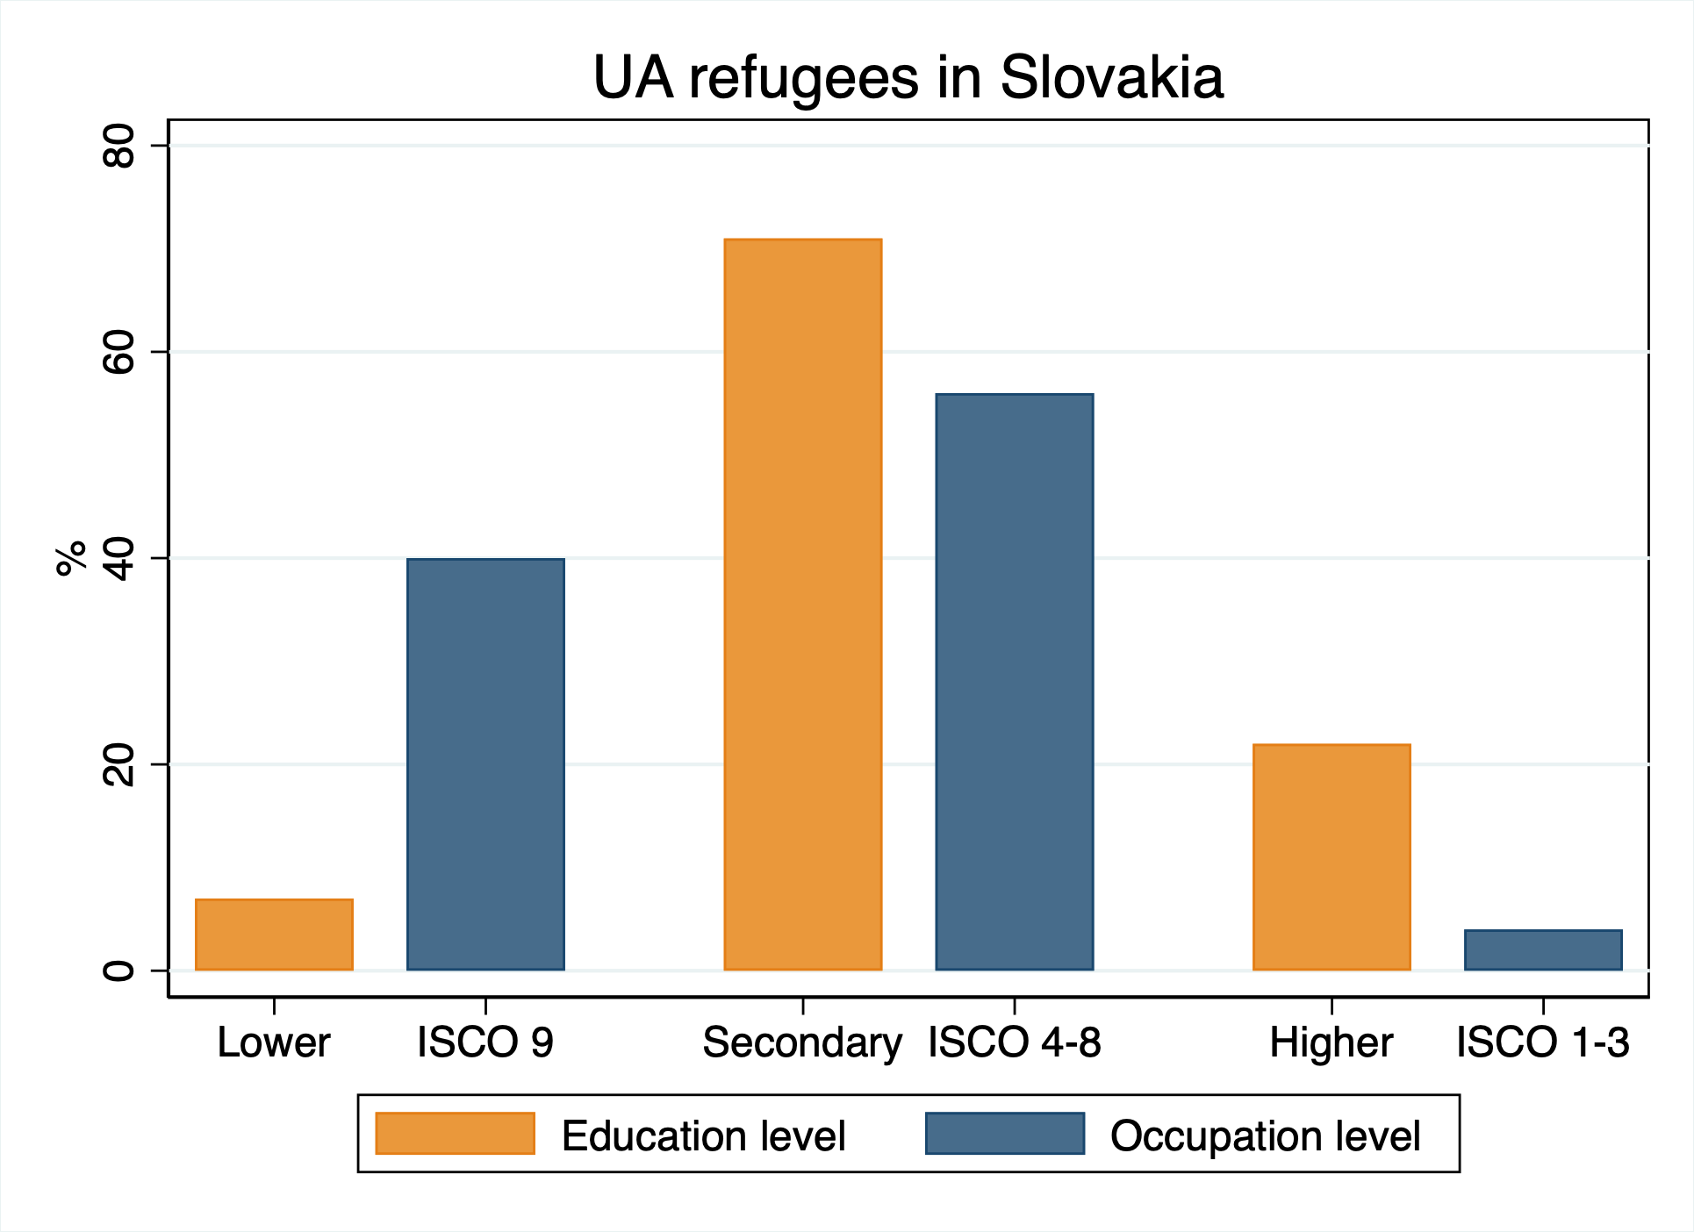
Overeducation – same old problem on a new scale
Taking jobs below qualification
Difficulties getting degrees recognised
Mismatch with the skills in demand
Lack of work experience
Data source: https://www.employment.gov.sk/files/slovensky/ministerstvo/analyticke-centrum/analyticke-komentare/komentare_2022/habel_veselkova_2022_zamestnanost_odidencov.pdf

Slide 15
The bottom line
Childcare (full-day, accessible and affordable)
Quick, unbureaucratic recognition of educational credentials
Identifying intentions to stay – training, re-education and paving a way for long-term employment

Slide 16
Thank you for your attention!
Follow us:
www.wiiw.ac.at

